Slide 1
Ad Hoc OLAP Queries
Matthew DeStefano

Slide 2
Project Overview
The python program uses phi operator inputs via inline inputs or from a text file to generate a python script that executes sql, mf, and emf queries
The python program can be run with `py \main.py`
And the generated file can be run via `py \generate.py`
Other information can be found in the README.md file

Slide 3
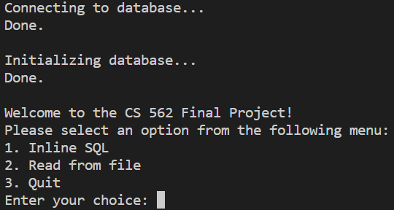
How it works
Program establishes a connection to the database and populates it
Program will prompt input to either read from file, enter data inline, or exit
Once inputs are read, script will determined sql, mf, emf
Generate file is created with prefix, type

Slide 4
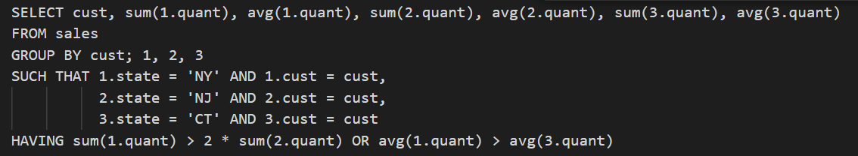
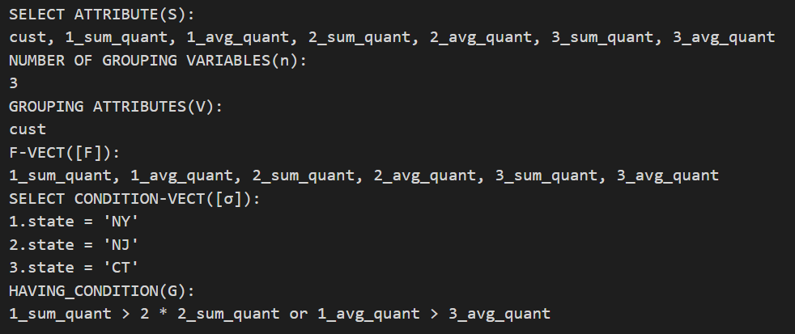
Query Structure
Can be found in template.py

Slide 5
Technologies used
Postgre Sql - PgAdmin for storing the database
May require updating user/pass on new machine
Python 3.7.1
Psycopg2 library for interacting with db
PrettyTable library for displaying results
VsCode environment

Slide 6
Technical Limitations and Future features
In line inputs are not checked for formatting errors
Issues with reading column names
SQL queries pull columns wrong if not in order
MF and EMF queries sometimes do not pull columns correctly
Option to auto run generated file from main.py
Ability to copy generated files to a saved directory

Slide 7
Summary
The program generates sql, emf, and mf queries using phi operators to be less resource intensive on the computer, and have less calls to the database.

